Slide 1
Michael Richardson
MULTI-PLATFORM, MULTI-PLAYER, FRAMEWORK FOR GAMES

Slide 2
Abstract
This project is to build multi-player and multi-platform space-themed games with a modular architecture, variety of supported network protocols, and elements of gameplay for both entertainment and education. My portion of the project is developing the framework in which these games will run. I defined requirements, designed, built and tested a server and game engine to run in Python on a Linux machine and clients to run on a Windows desktop or on the web.

Slide 3
Objectives
Modular Architecture
Platform Independence
Network Protocol Independence
Abstraction of Networking and Data Storage
Excellent Documentation

Slide 4
Modular Architecture
Server Module
Game Engine Modules
Client Modules

Slide 5
Platform Independence
Server runs anywhere
Python
Game Engine can run anywhere
Python
Clients can run anywhere
JavaScript
Responsive Web Design
Clients can run in any language
C#, JavaScript, etc . . .

Slide 6
Network Protocol Independence
Universal Data Format
JSON
The Server Communicate over Multiple Network Protocols
HTTP and WebSockets
Game Engine Communicate over Multiple Network Protocols
HTTP and WebSockets
Clients Communicate over Multiple Network Protocols
HTTP and/or WebSockets

Slide 7
Abstraction of Networking and Storage
Get Game Updates
Process Game Updates
Issue Game Commands

Slide 8
Excellent Documentation
The Role of Software Documentation:
To facilitate program comprehension
To act as a guide to the user
To complement the system
Penny Grubb and Armstrong Takang. Software Maintenance: Concepts and Practice

Slide 9
Excellent Documentation
JSON Objects
JSON Messages
Logic Diagrams
Protocol Dialogue Diagrams

Slide 10
Design
Network Architecture
Logic
Dialogues
Interface

Slide 11
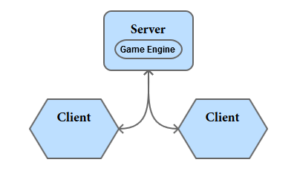
Network Architecture

Slide 12
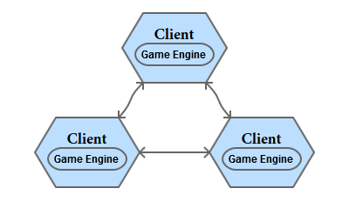
Network Architecture (Option)

Slide 13
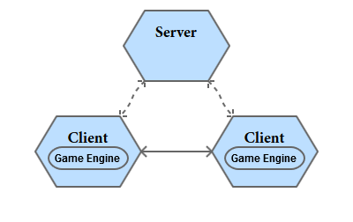
Network Architecture (Option)

Slide 14
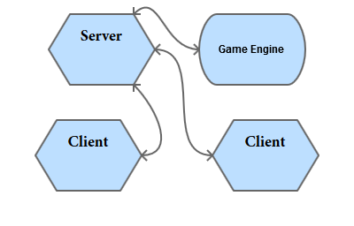
Network Architecture (Option)

Slide 15
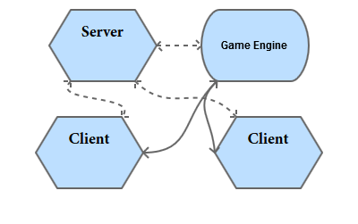
Network Architecture (Choice)

Slide 16
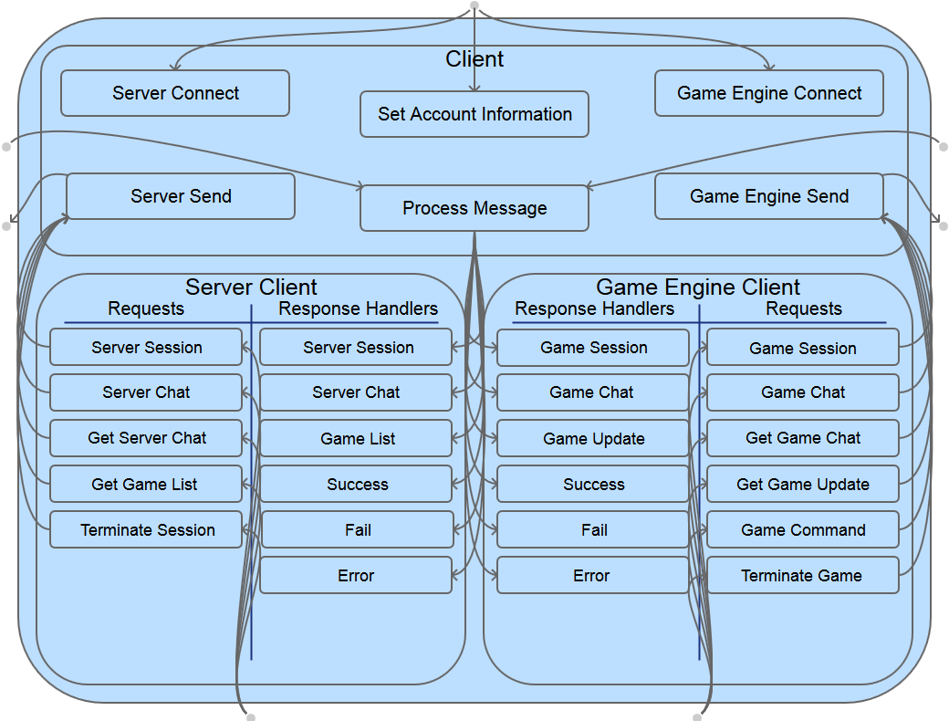
Client Logic

Slide 17
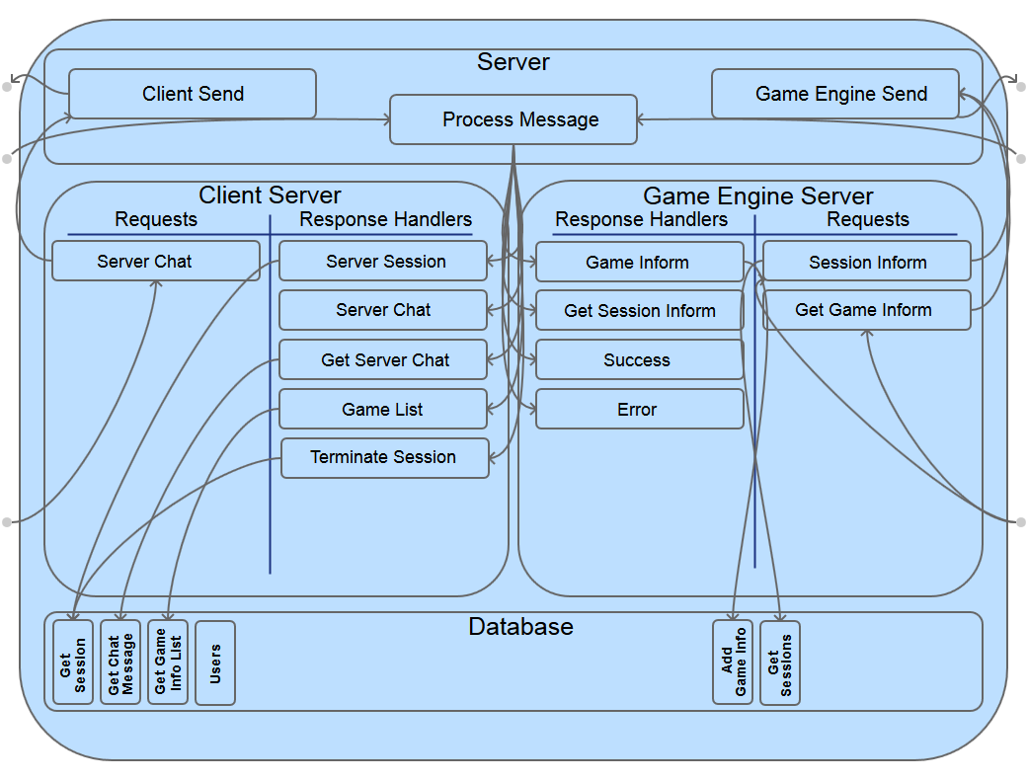
Server Logic

Slide 18
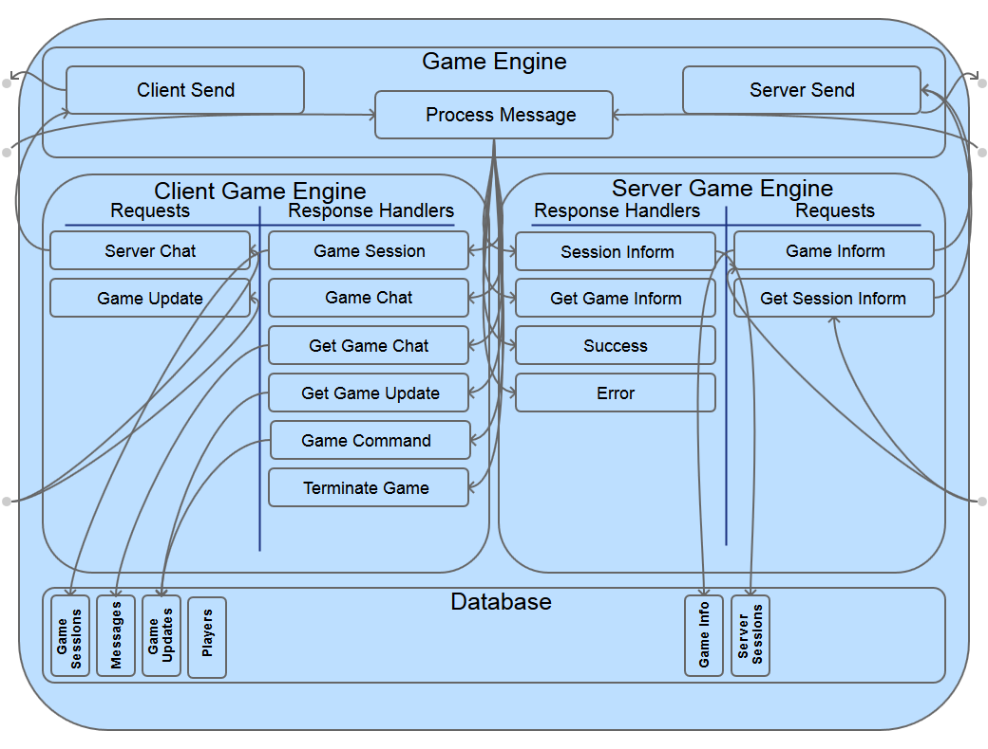
Game Engine Logic

Slide 19
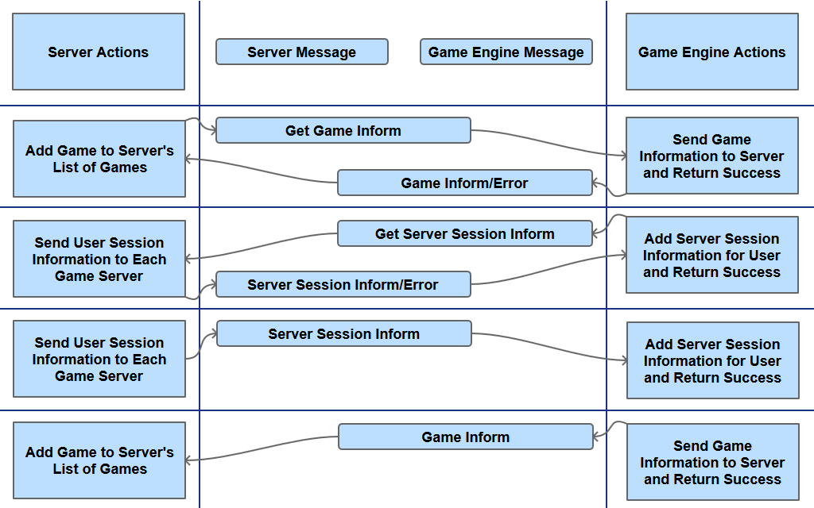
Server - Game Engine Dialogue

Slide 20
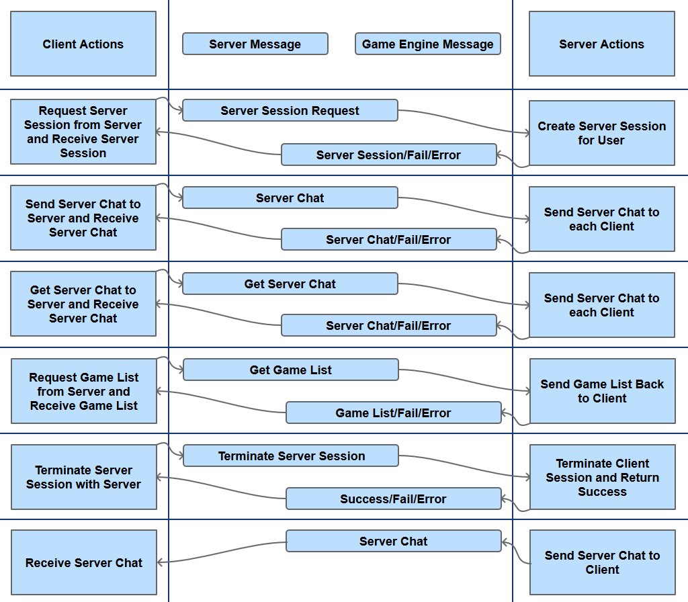
Client - Server Dialogue

Slide 21
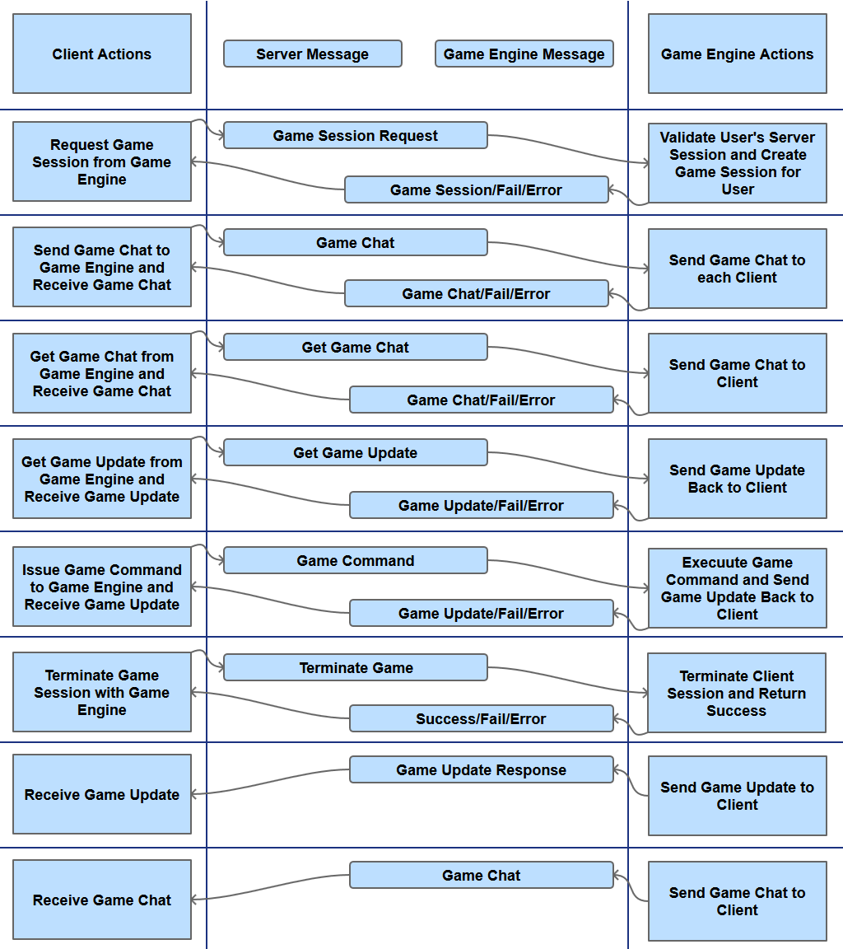
Client - Game Engine Dialogue

Slide 22
Interface Design
Responsive Web Design
Desktop Native
Desktop Web
Desktop Mobile

Slide 23
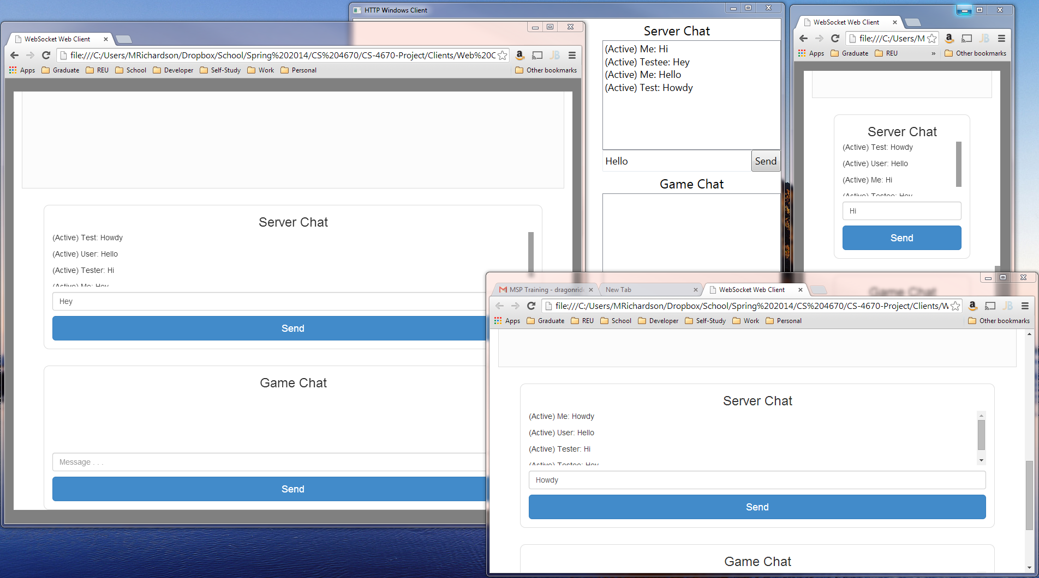
Interface Design

Slide 24
Responsive Web Design
“Fluid grids, flexible images, and media queries are the three technical ingredients for responsive web design, but it also requires a different way of thinking.” Responsive web design requires thinking about the design of a web site holistically, preserving the conceptual integrity of the site while providing optimal presentation across a variety of viewing experiences.”
Marcotte, Ethan. 2010. Responsive web design. In A list apart

Slide 25

Responsive Web Design Twitter Bootstrap

Slide 26
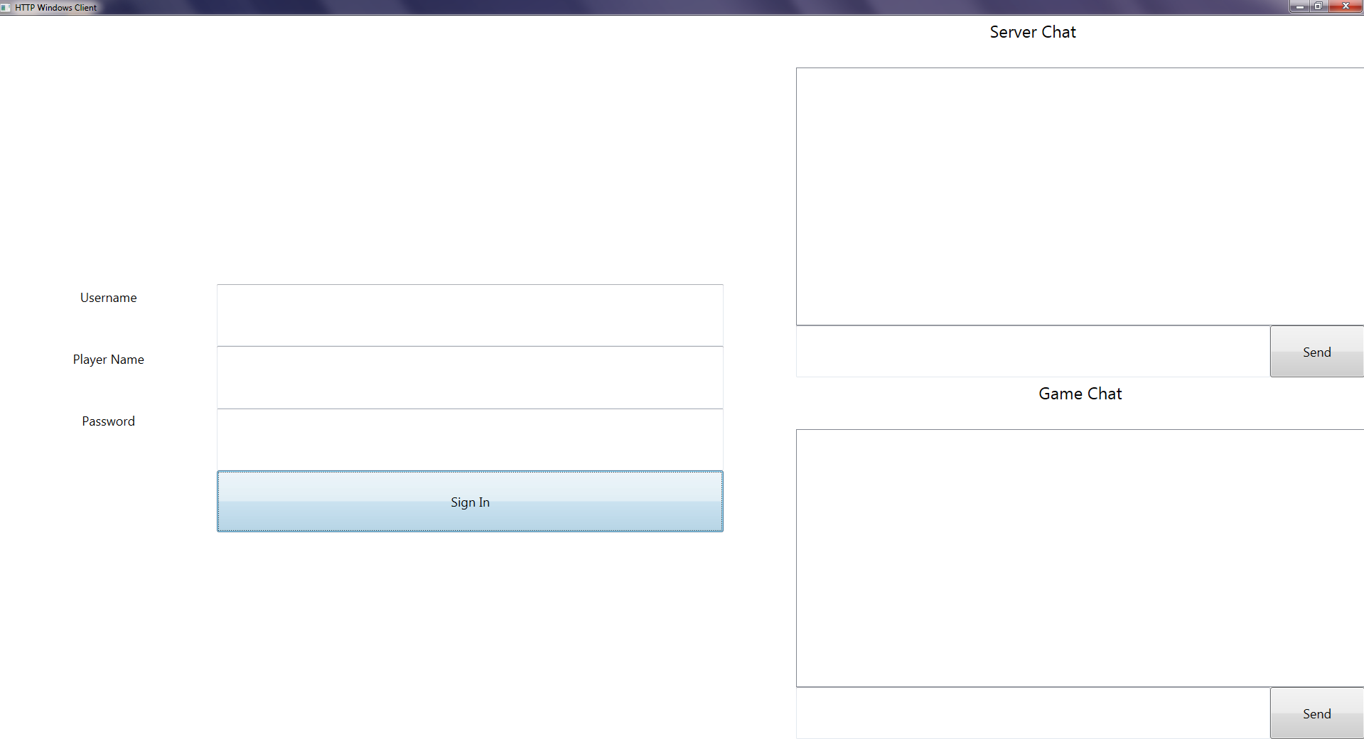
Desktop Native (Large)

Slide 27
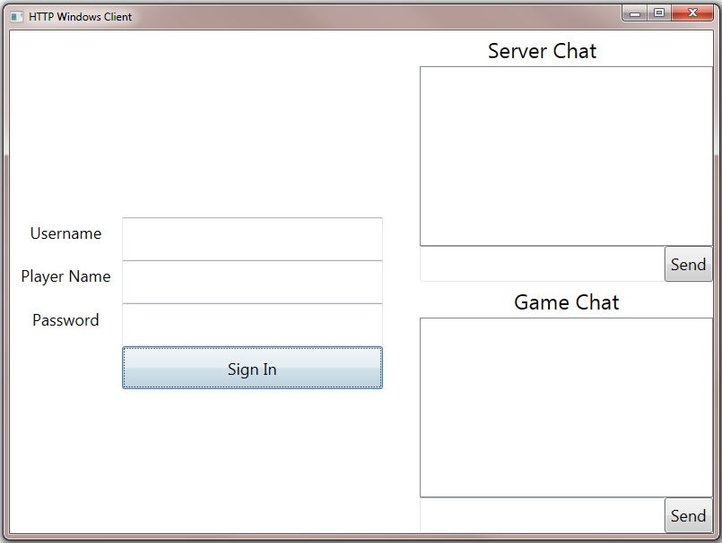
Desktop Native (Small)

Slide 28
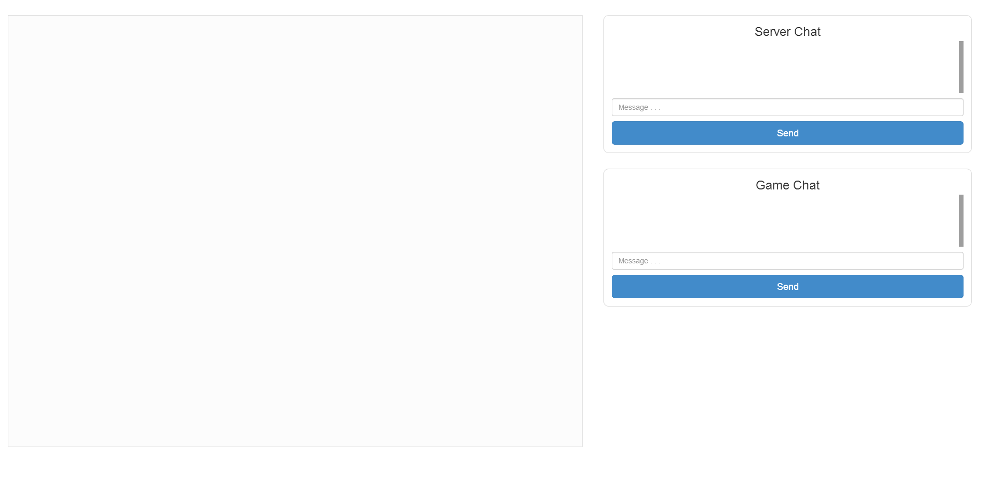
Desktop Web (Chrome)

Slide 29

Desktop Web (Internet Explorer)

Slide 30
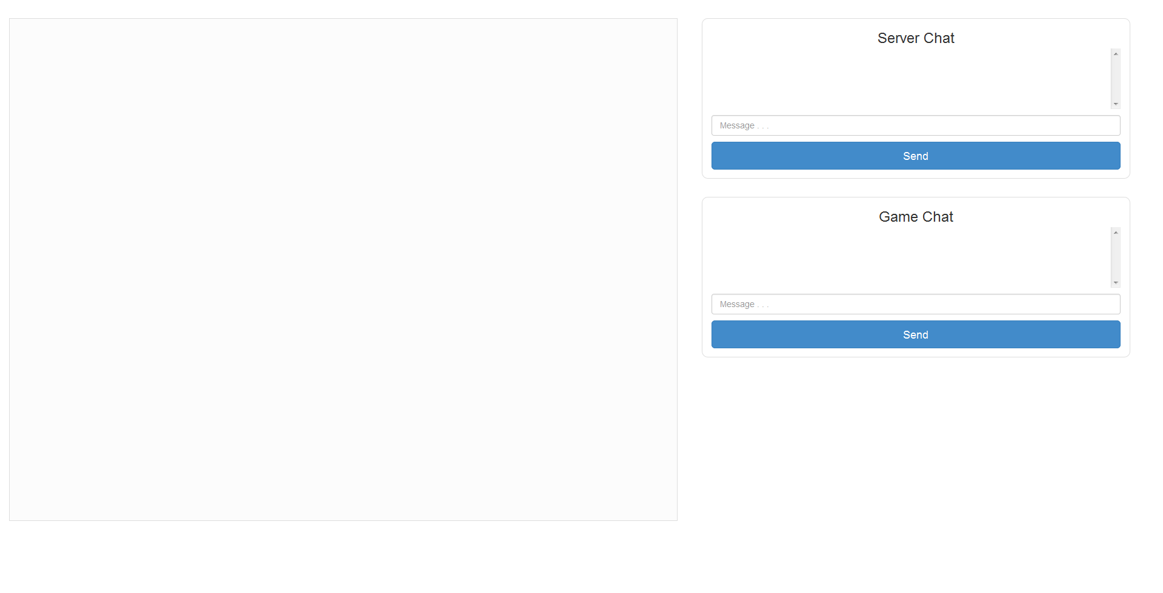
Desktop Web (FireFox)

Slide 31
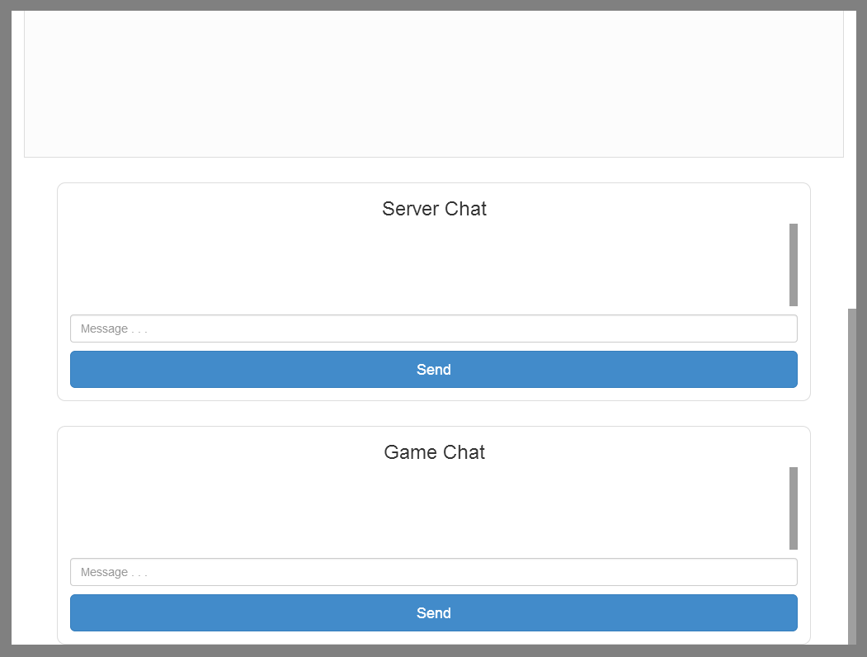
Mobile Web (ipad)

Slide 32
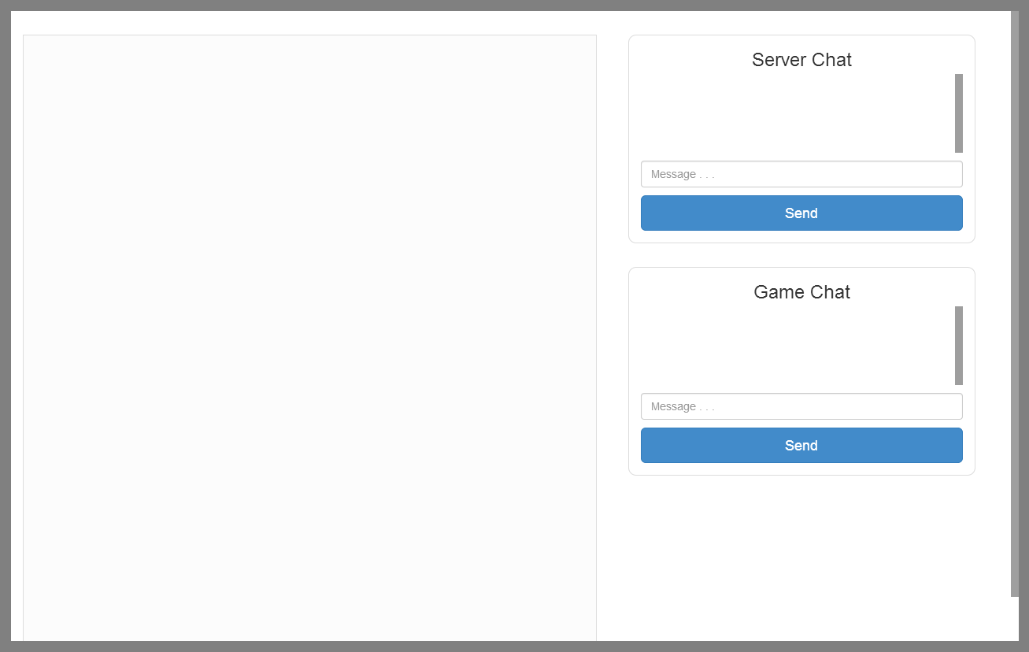
Mobile Web (Nexus 10)

Slide 33
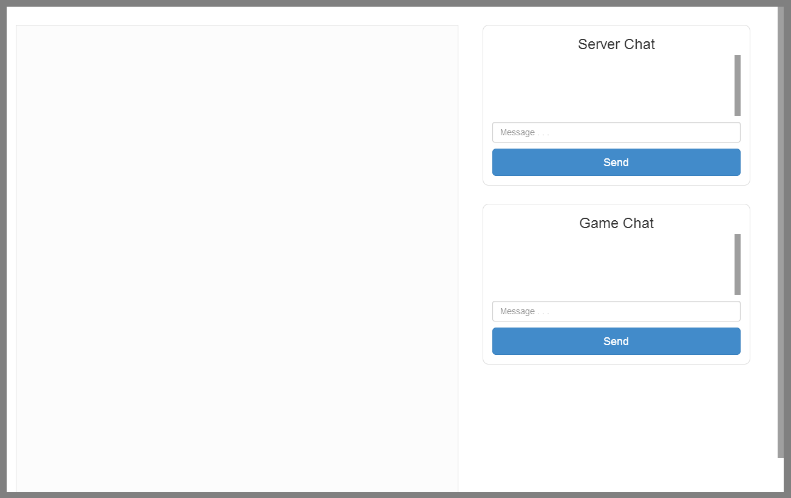
Mobile Web (Kindle Fire HD)

Slide 34
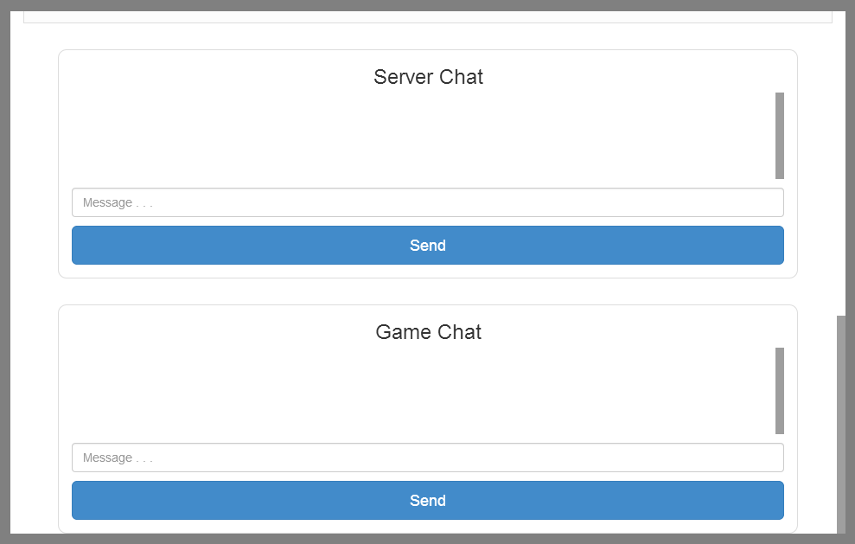
Mobile Web (Nexus 7)

Slide 35
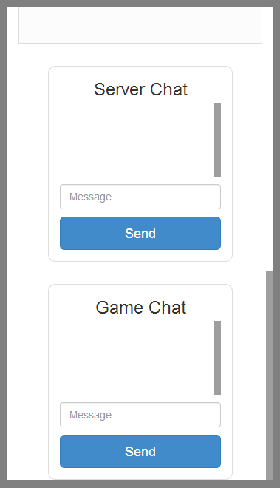
Mobile Web (Nexus 5)

Slide 36
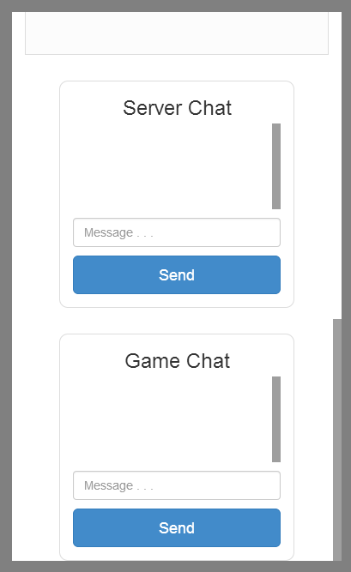
Mobile Web (BlackBerry)

Slide 37
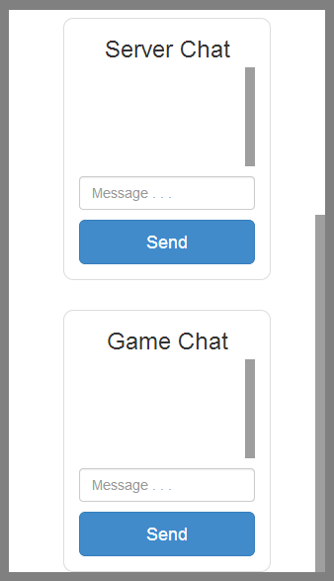
Mobile Web (iPhone)

